Slide 1



KONGU ENGINEERING COLLEGE
PERUNDURAI ERODE-638060
ARTIFICIAL INTELLIGENCE AND DATA SCIENCE
Data Modelling and Business Intelligence
Case Study-1
Digital Marketing - Campaign Performance Analysis
HIRTHEESH V J
23ADR063

Slide 2

Introduction
Digital marketing campaigns generate large amounts of data such as impressions, clicks, conversions, cost, and revenue.
Traditional databases are not efficient for complex analytical reporting.
Data Warehousing helps store and analyse historical marketing data.
Star Schema is a simple and effective dimensional model used for analytical systems.
This project focuses on analysing campaign performance using a Star Schema.

Slide 3
Business Scenario
A company runs multiple digital campaigns across platforms like social media, search engines, and email.
Problems faced:
Campaign data is scattered
Hard to measure ROI
Budget allocation is inefficient
Limited visibility into customer engagement
Objective:
Build a centralized analytical model to monitor, compare,
and optimize campaign performance.

Slide 4
Business Process
Main Process: Campaign Performance Tracking
Steps:
Campaign launched
Ads shown to users
Users click ads
Users convert (purchase/sign-up)
Cost and revenue recorded
Key metrics generated: Impressions, Clicks, Conversions, Cost, Revenue.

Slide 5
Grain (Level of Detail)
One record in the fact table represents one campaign per day
per channel.
This includes:
One campaign
One channel
One date
One customer segment or location
Correct grain ensures:
Accurate analysis
No duplication
Clear reporting structure

Slide 6
Fact Table
The fact table stores measurable performance metrics.
Fact Table: Campaign_Facts
Measures (Facts):
Impressions
Clicks
Conversions
Cost
Revenue
ROI
This table is numeric and supports aggregation.
Foreign Keys:
Date
Campaign
Channel
Customer_Segment
Location

Slide 7
Dimension Tables
Campaign Dimension Campaign_ID (PK) Campaign_Name Campaign_Type Budget Start_Date End_Date
Channel Dimension Channel_ID (PK) Channel_Name Platform Channel_Type
Customer Segment Dimension Segment_ID (PK) Age_Group Gender Interest_Category Income_Level
Location Dimension Location_ID (PK) Country State City Region
Time Dimension Time_ID (PK) Date Month Quarter Year

Slide 8
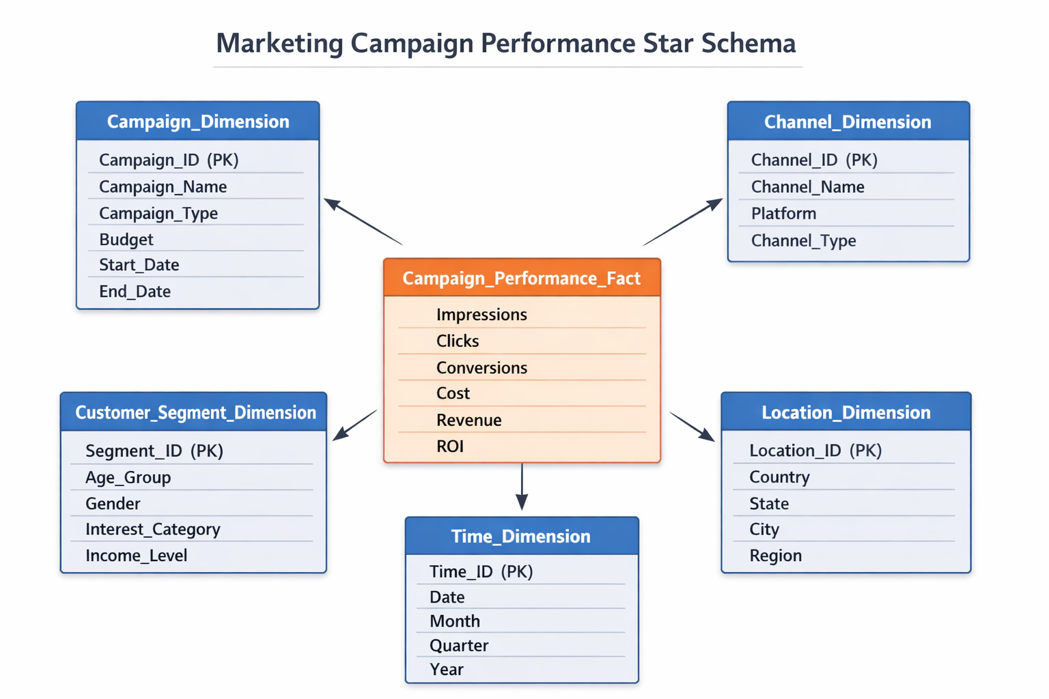
Star Schema Structure

Slide 9
Case Study
Case Study: Digital Marketing Agency
After implementing Star Schema:
Analysis Results:
Identified high-performing campaigns
Found most profitable marketing channels
Improved conversion rates
Reduced unnecessary advertising cost
Optimized marketing budget allocation
Business Benefits:
Faster decision making
Better campaign planning
Improved ROI
Increased customer engagement
Higher overall profitability

Slide 10
Conclusion
Digital marketing generates large-scale transactional data.
A well-designed Star Schema helps organize and analyse this data efficiently.
Proper grain definition and structured fact and dimension tables enable accurate reporting and performance evaluation.
This model supports management in analysing campaign effectiveness, customer behaviour, and revenue trends.
Thus, Star Schema enhances marketing analytics and improves overall business performance.

Slide 11
Thank You !!

